Slide 1
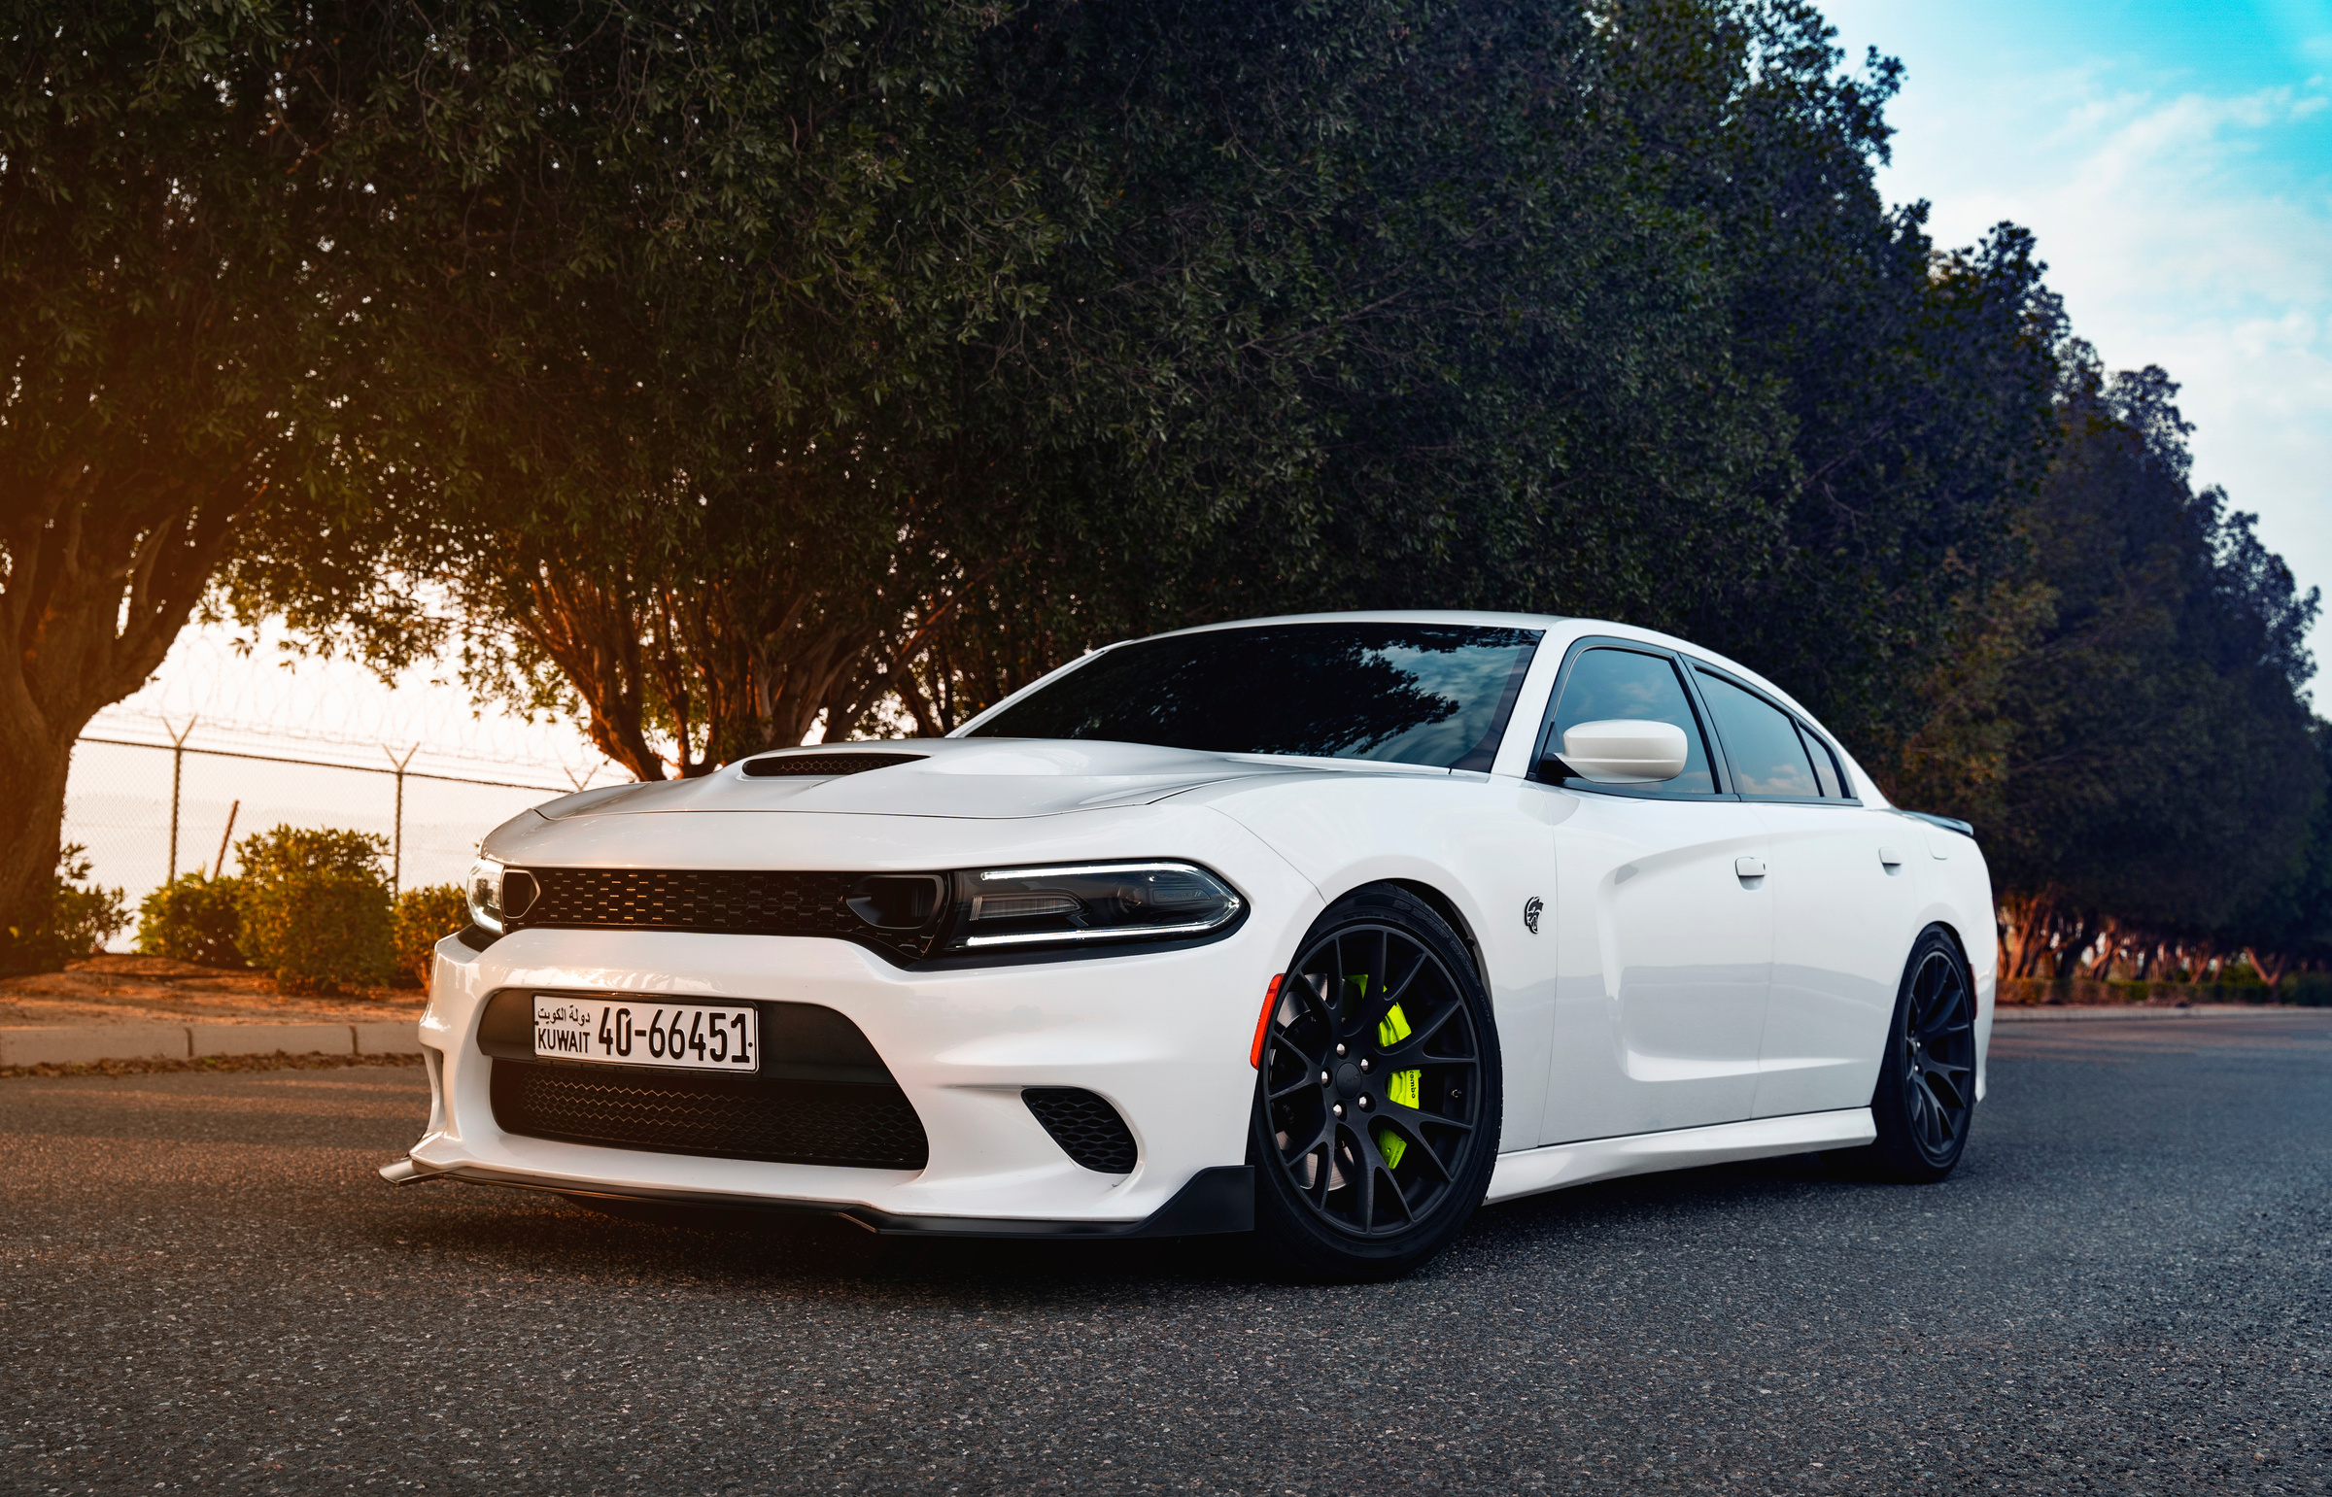


DEMONCARS
www.demoncars.online

Slide 2

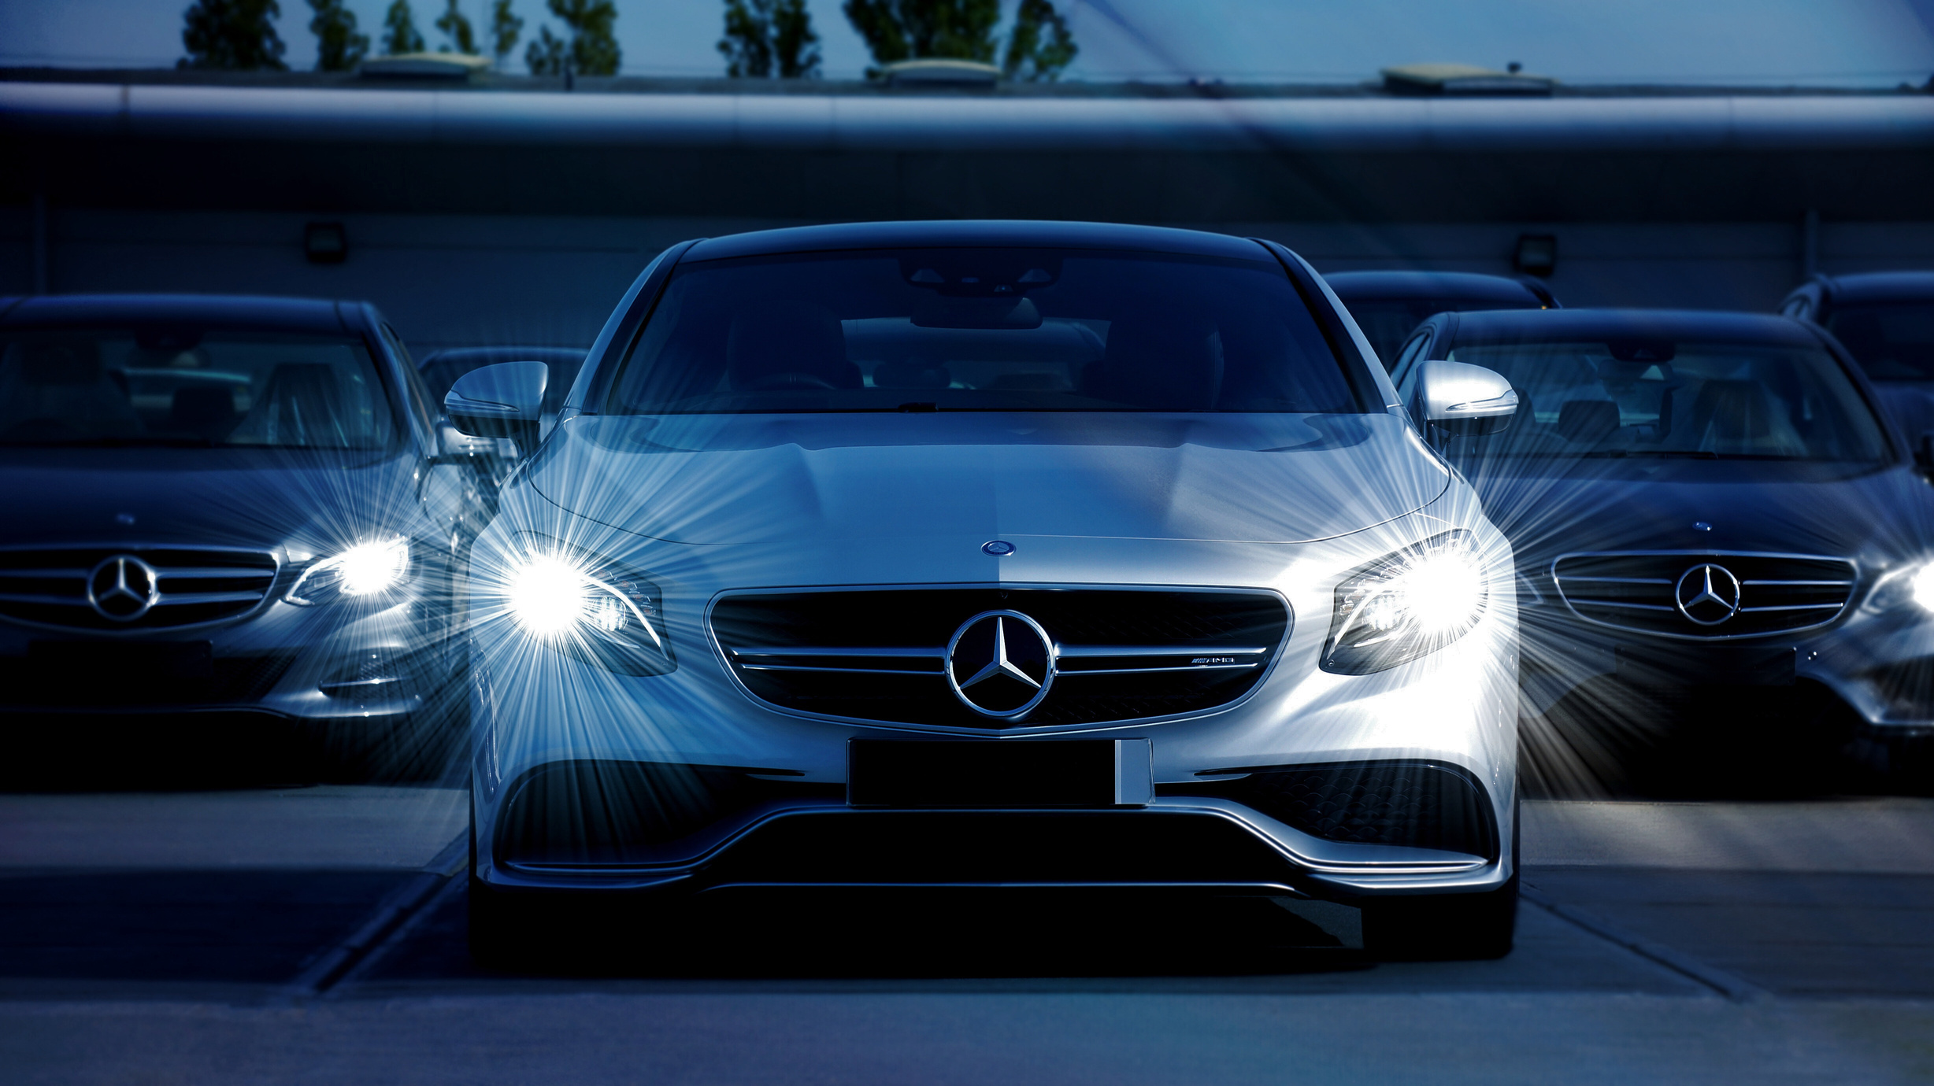
THE PROBLEMS WITH TRADITIONAL CAR buying
TIME REQUIREMENT
UNCERTAINTY
OPACITY
WHEN BUYING A USED CAR, YOU SHOULD NEVER sure about the condition of the vehicle. Hidden mistakes, hidden injuries , all of it poses a risk
FINDING THE RIGHT CAR TIME-CONSUMING PROCESS. ADVERTISEMENTS BROWSING, CAR DEALERSHIPSVISIT, TEST DRIVES ,ALL OF THIS TAKES A LOT OF TIME.
WHEN BUYING A CAR, YOU OFTEN THERE IS A LACK OF INFORMATION. THE SELLERS ARE NOT ALWAYS HONEST, AND IT IS DIFFICULT
POSES A RISK. DECIDE WHETHER THE PRICE OFFERED IS REALISTIC.

Slide 3
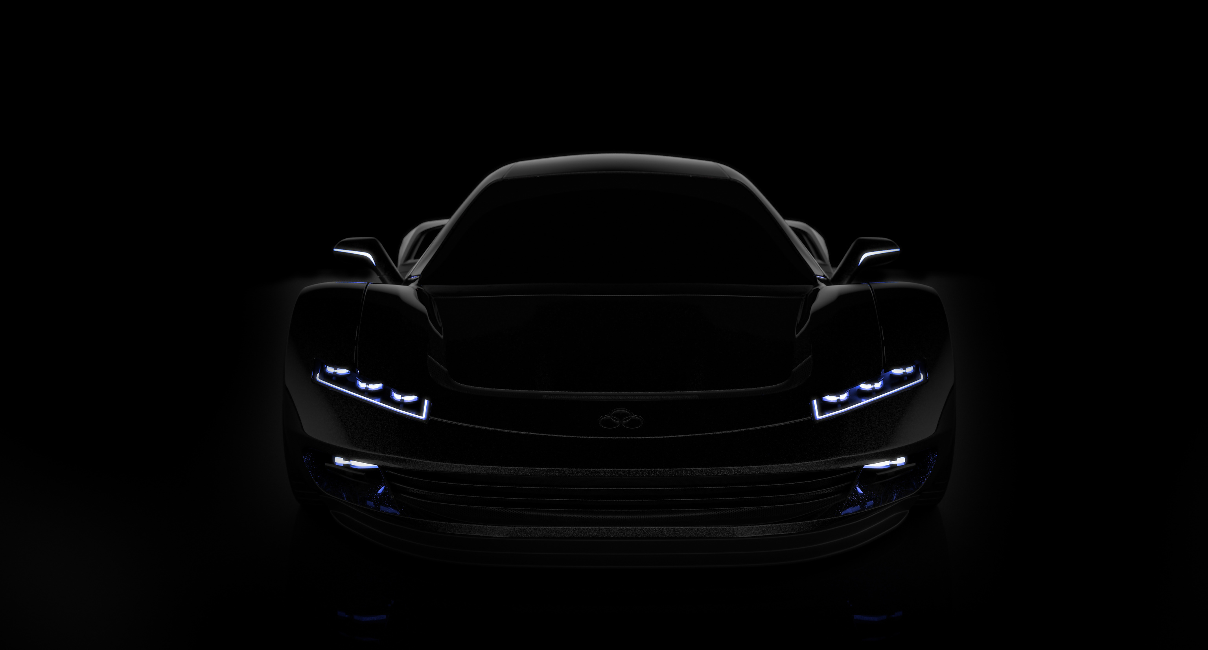


FRESH SERVICE, new parts
All our cars are thoroughly serviced. We ensure that even the smallest errors be repaired, only the new one goes to the owner.
Only quality, new parts we use It needs to be replaced elements are the best, factory replaced with spare parts.
We are proud of our work, that's why for every car we offer
we guarantee. That way you are calm can also be done after the purchase.

Slide 4
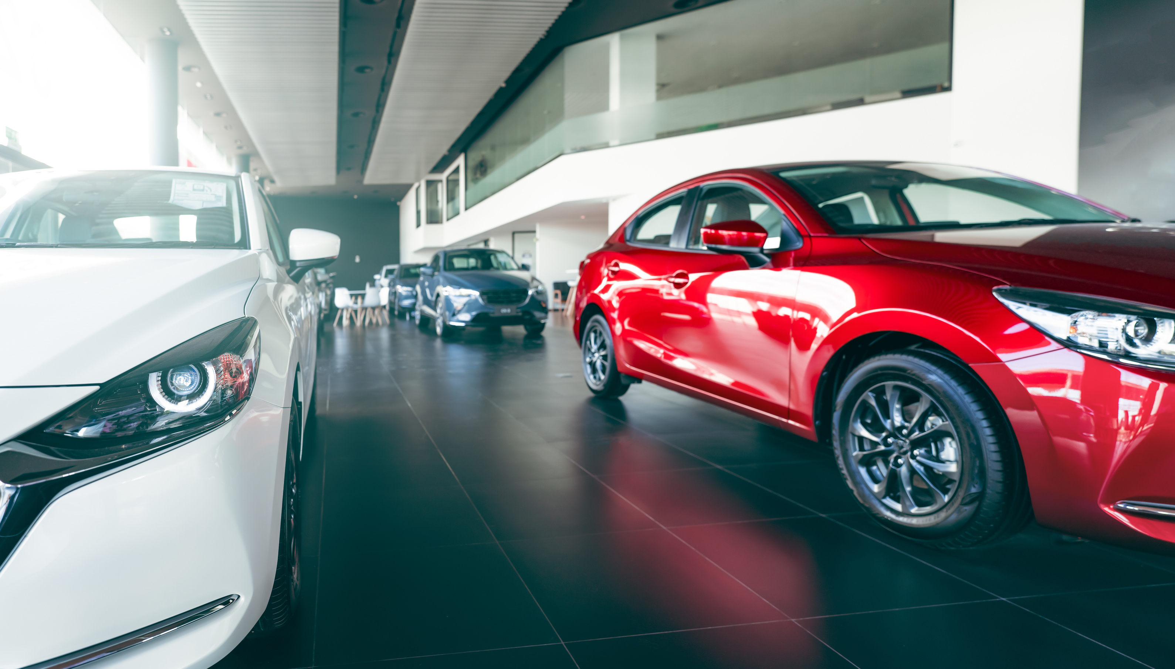




Offer of new cars
Wide selection
Excellent offers
Favorable Opportunities
Innovation
Offered by DemonCars can be found in
most popular brands and models.
We help you find it
needs and budget
most suitable car.
We do it with flexible and competitive financing solutions
enable you to buy a car.
DemonCars is revolutionizing car shopping with personalized offers and on-site 3D showrooms.

Slide 5
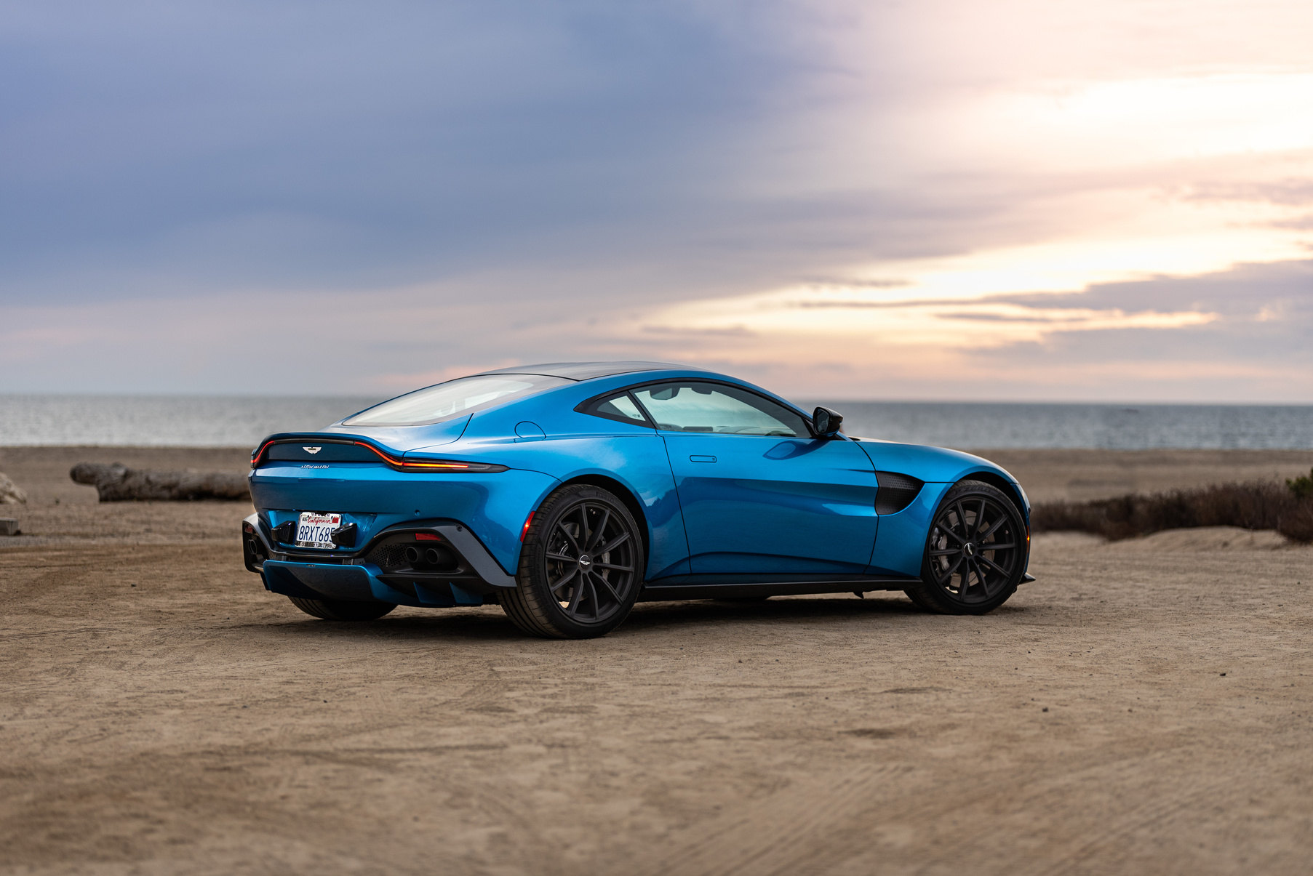
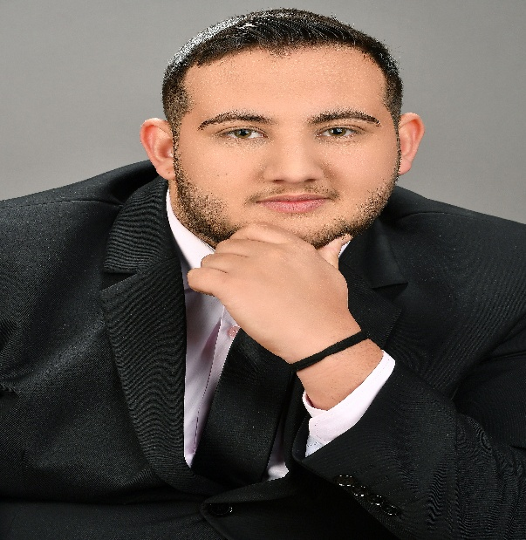
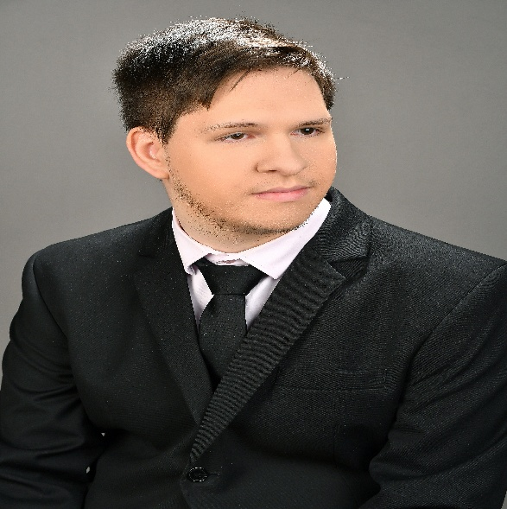

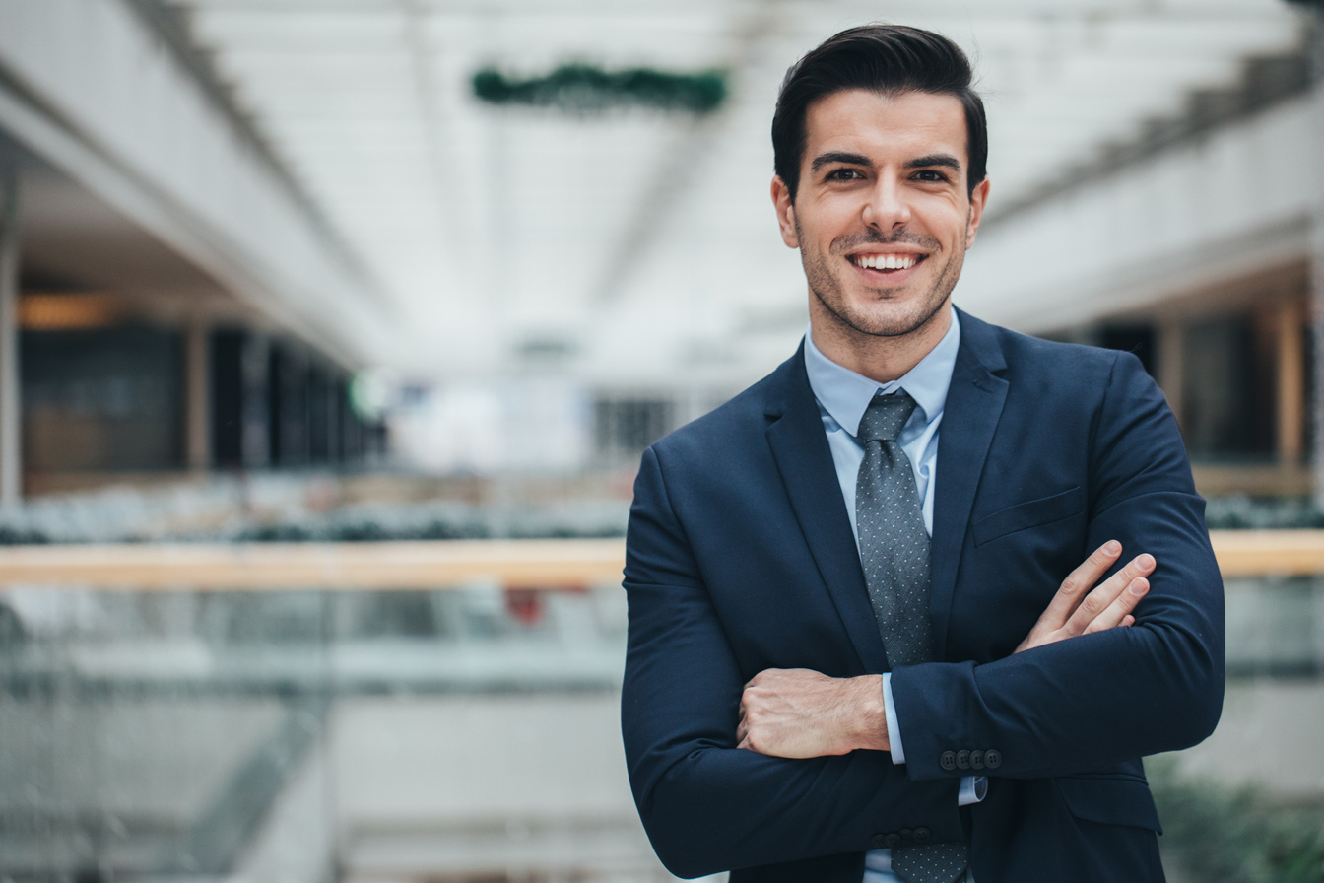

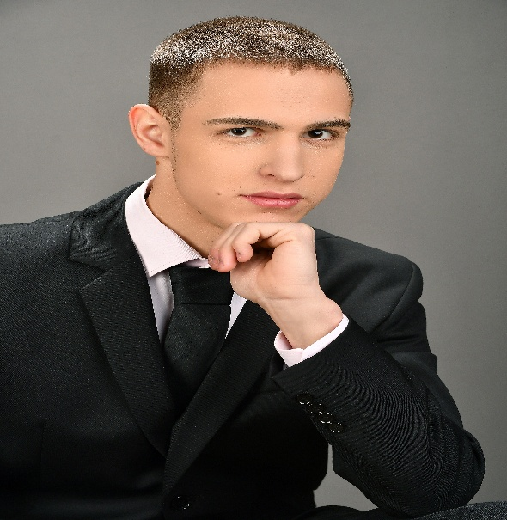
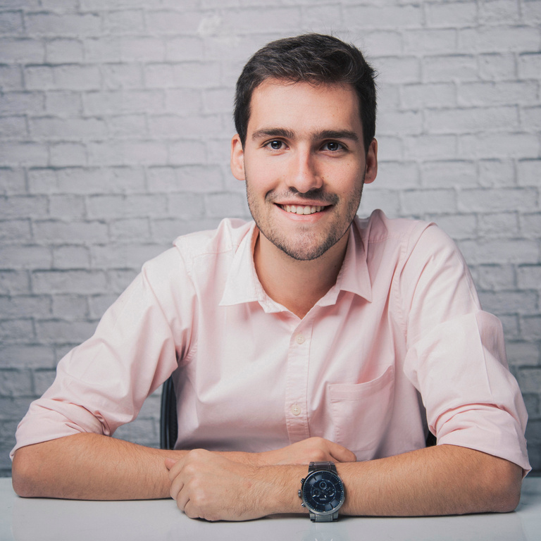
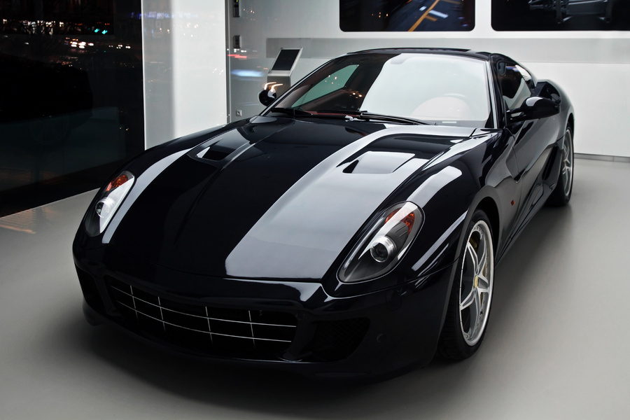
The team
Kelemen János(backend)
Kollár Bence(database)
It works in the background. His job is server-side logic, that is database management and ensuring the functionality of the website.
Database expert. He is responsible for the safe storage of data, for its organization and efficient querying.
Gáspár Balázs(frontend)
Responsible for the user interface. He makes sure the website is spectacular and its easy-to-use appearance.

Slide 6



TEAMWORK
Our team worked efficiently, easily coped with challenges, and found quick, effective solutions. Cooperation and clear communication made teamwork smooth and successful.
01
We stayed in sync via Discord and Messenger, ensuring seamless teamwork. We distributed improved codes and updates to each other with the help of Git or Discord, so we could work in coordination
02
We dealt with all problems together and found effective solutions. Our teamwork made it possible to quickly identify and correct errors, ensuring a smooth development process.
03

Slide 7
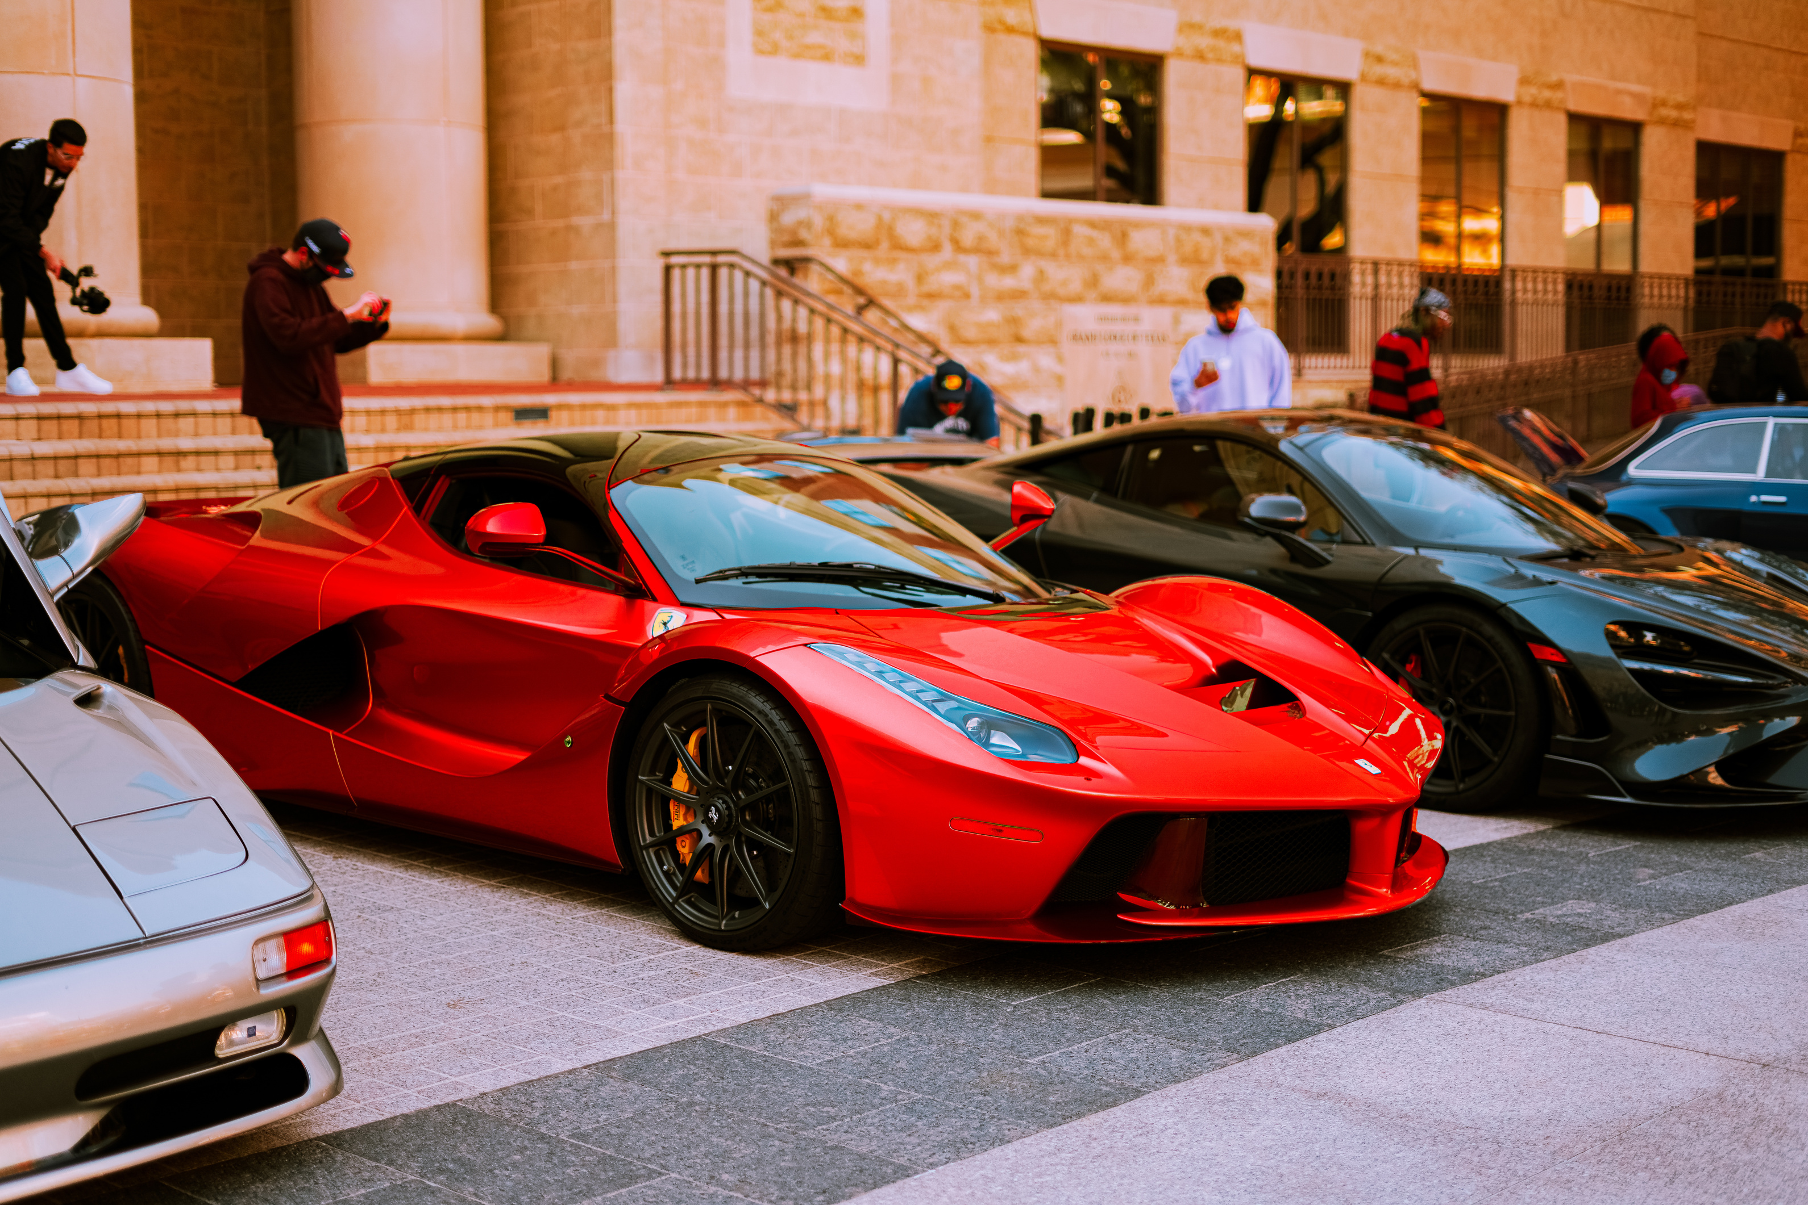



PROJECT TIMELINE
We organized our time efficiently, divided the tasks, and set clear deadlines. By prioritizing work and being flexible, we made steady progress and efficiently met our goals.
Completing tasks
Schedule
Objectives

Slide 8
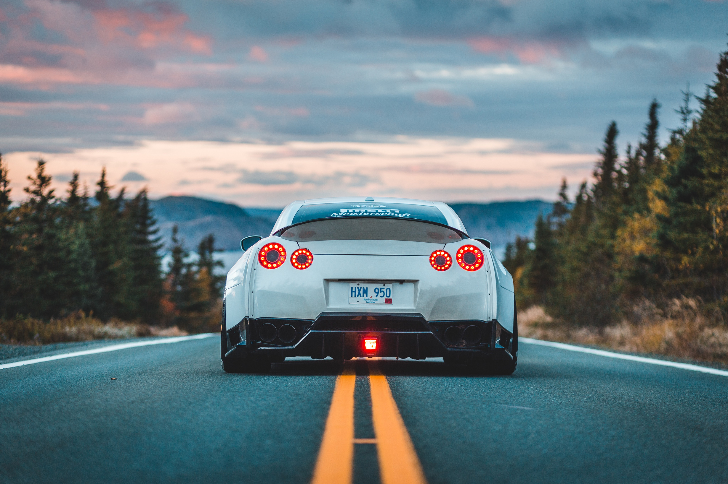
FEATURES
Login
Registration
Forgott password and username

Slide 9
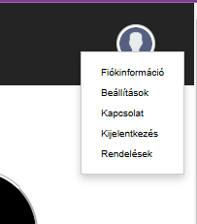
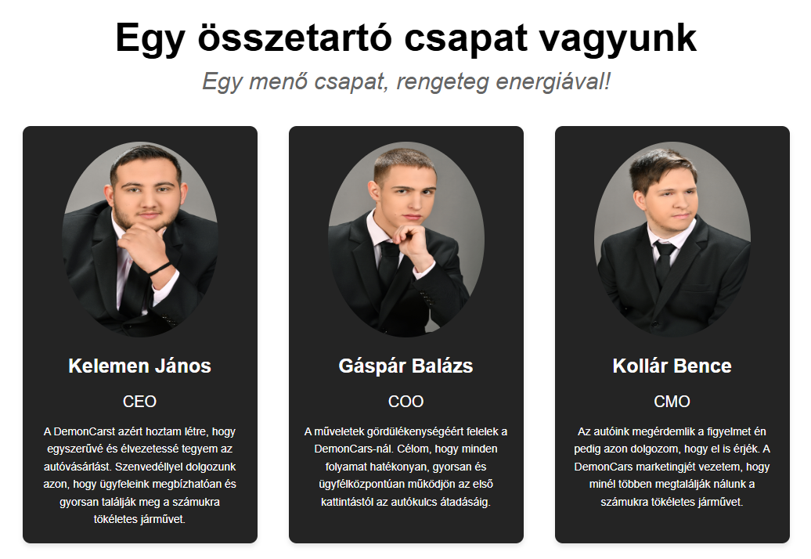
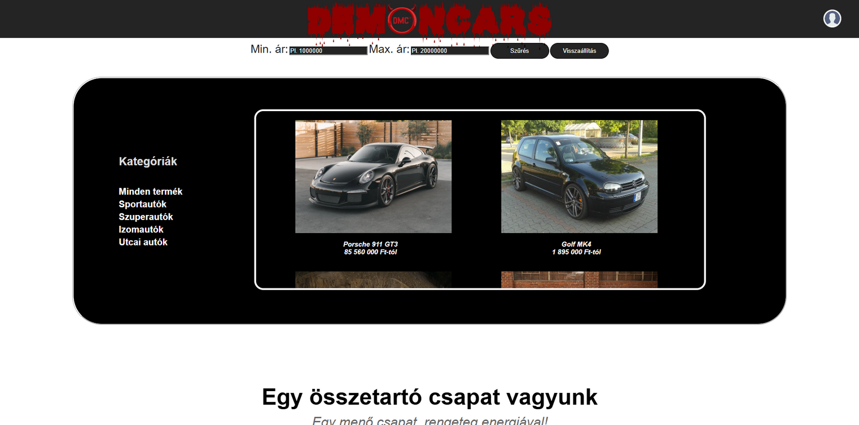
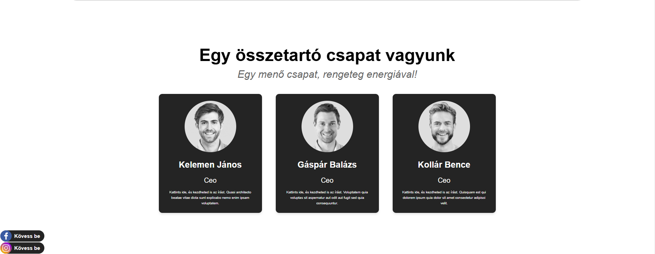


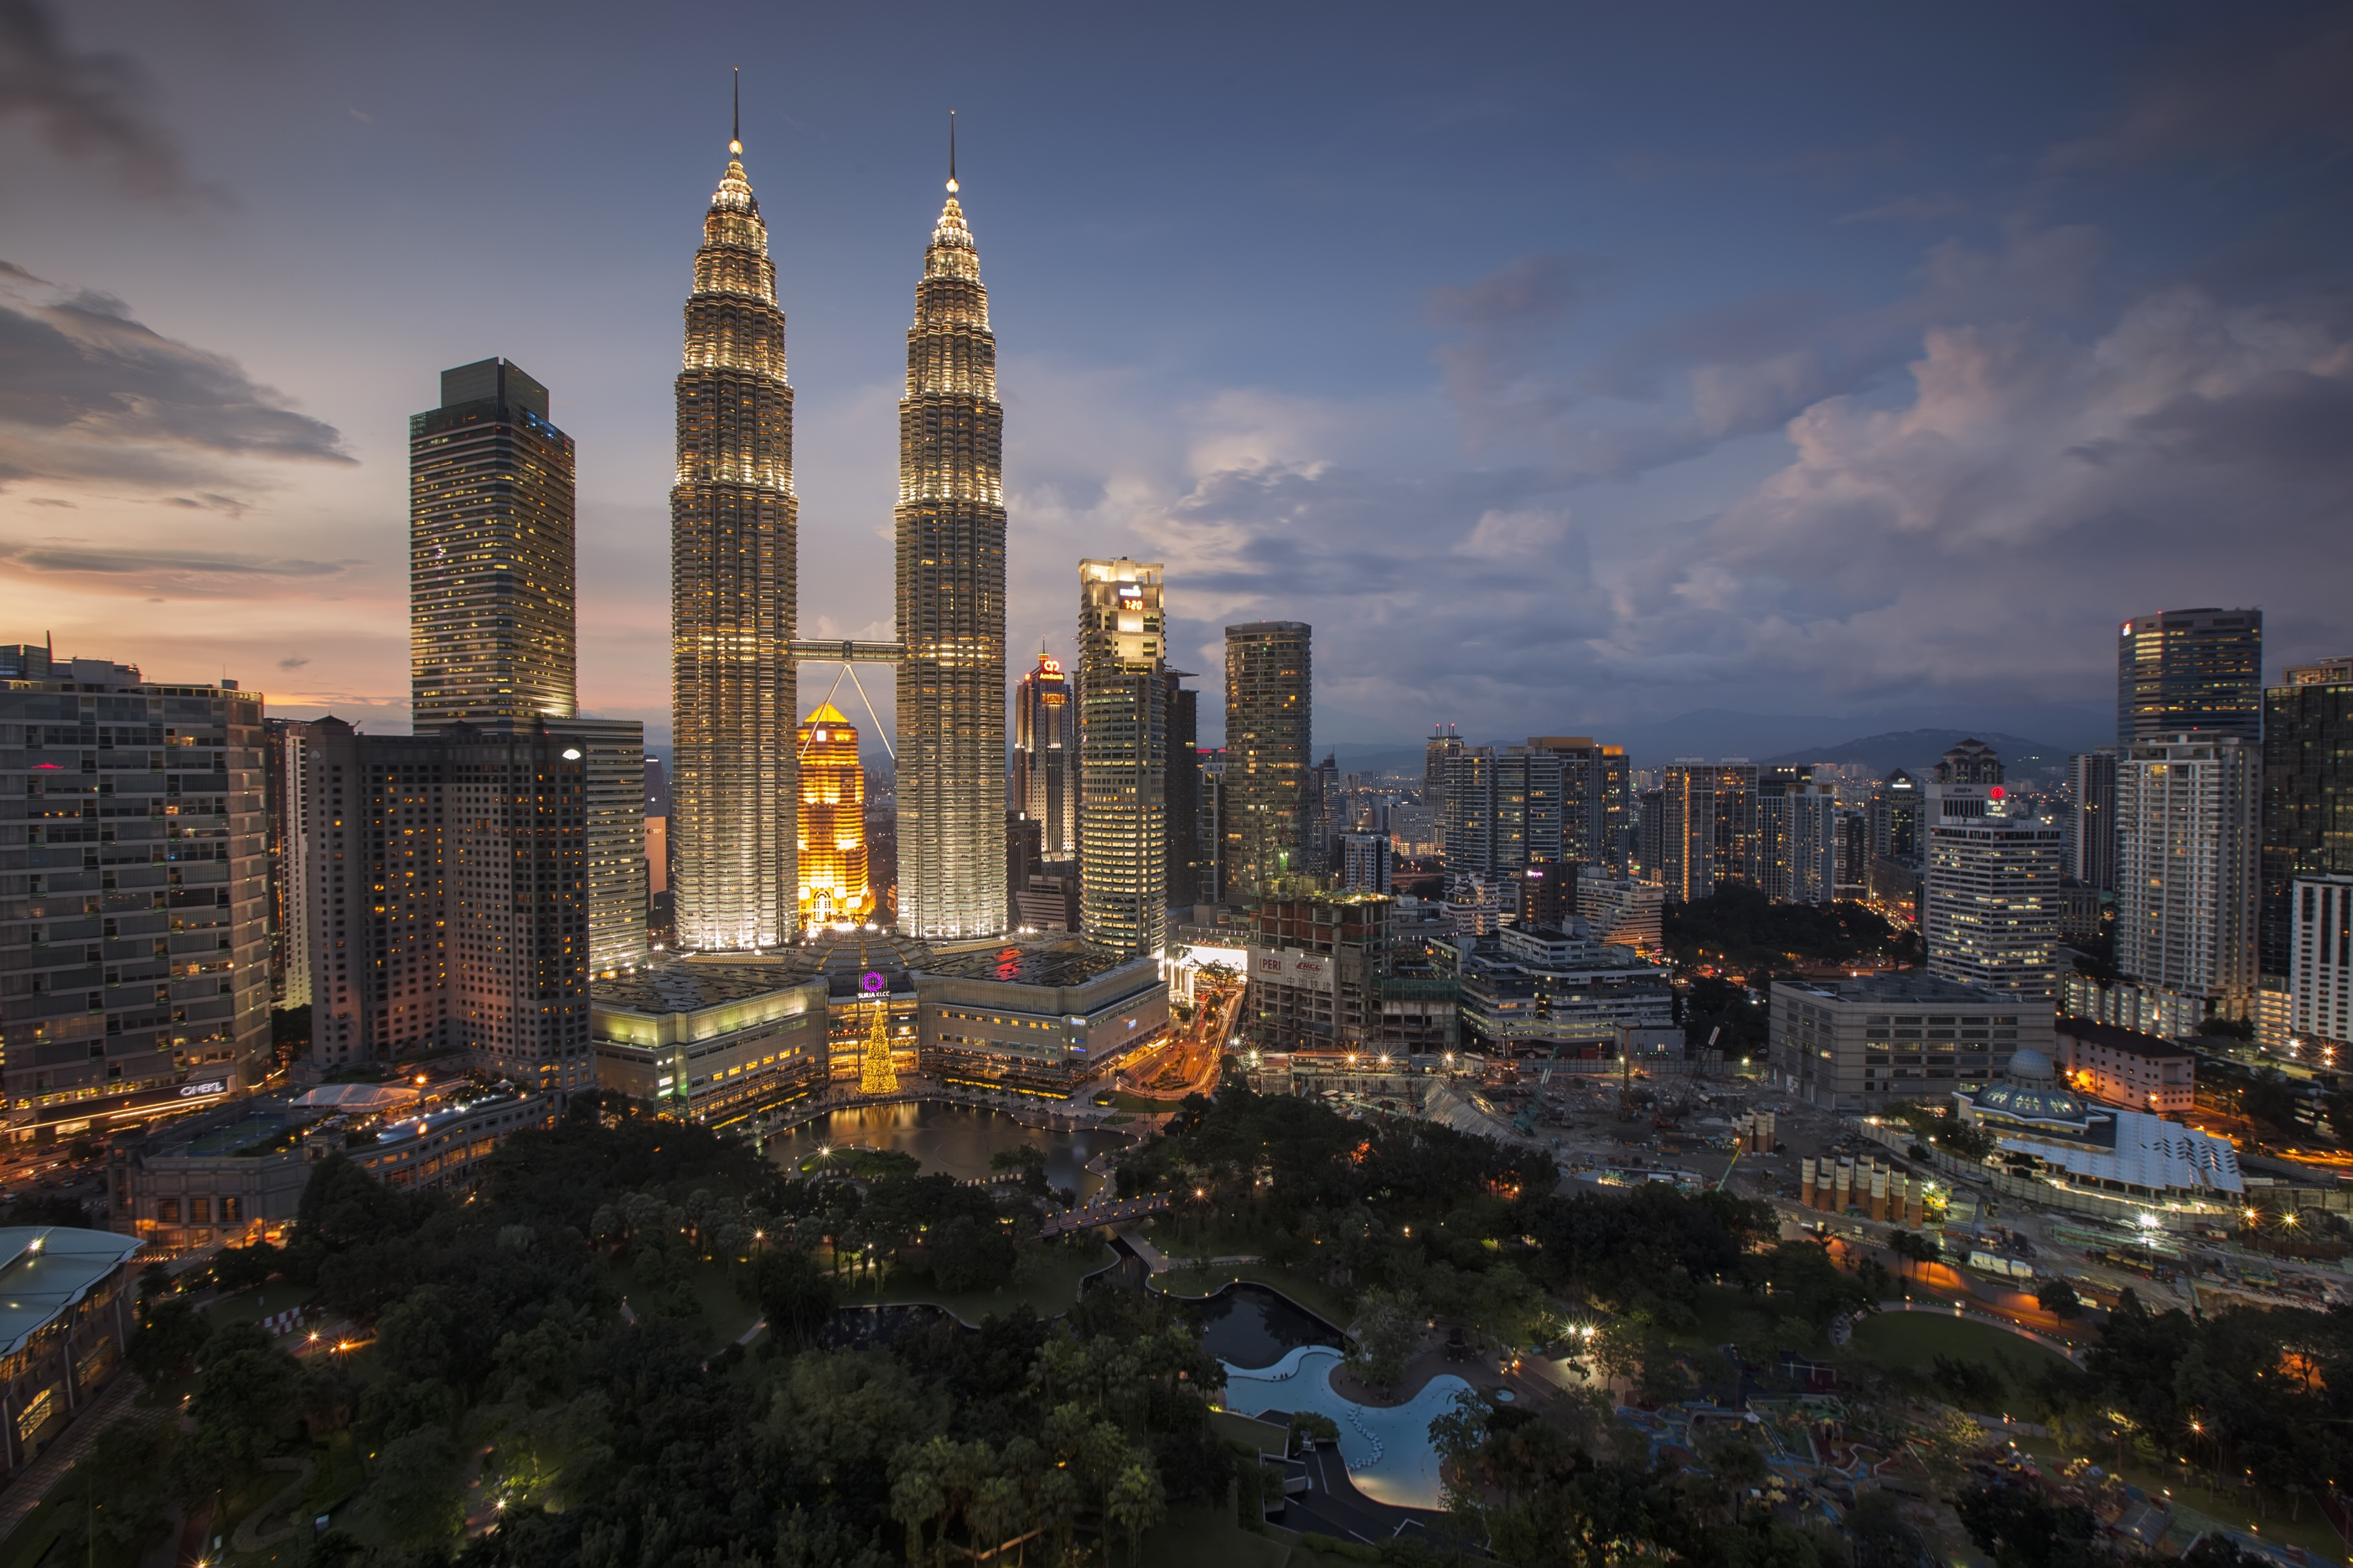
PAGES
Main page
Team presentation

Slide 10
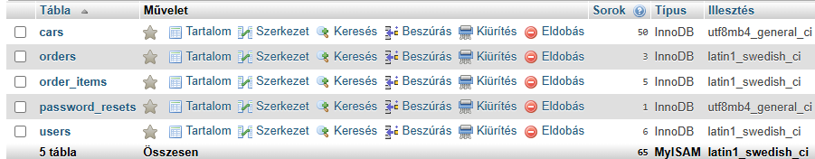
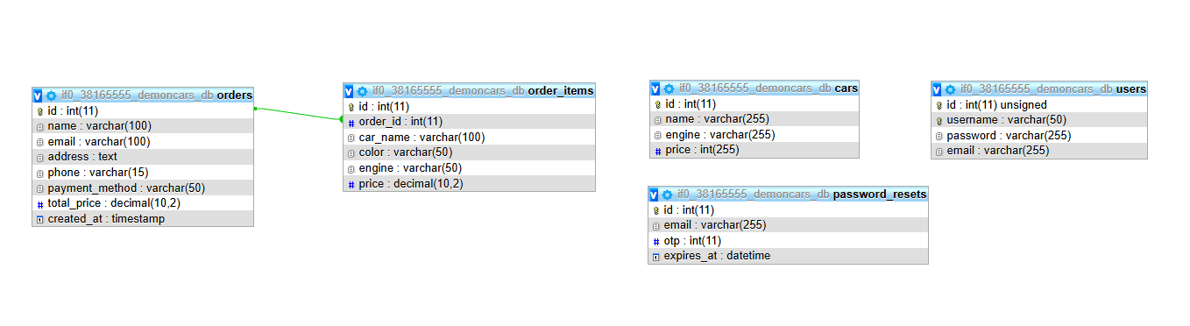
DATABASE

Slide 11






FURTHER DEVELOPMENT OPPORTUNITIES
01
02
AI Technologies
Digital Showroom
DEMONCARS
03
04
05
Compare cars
Used car filter
Service and maintenance

Slide 12
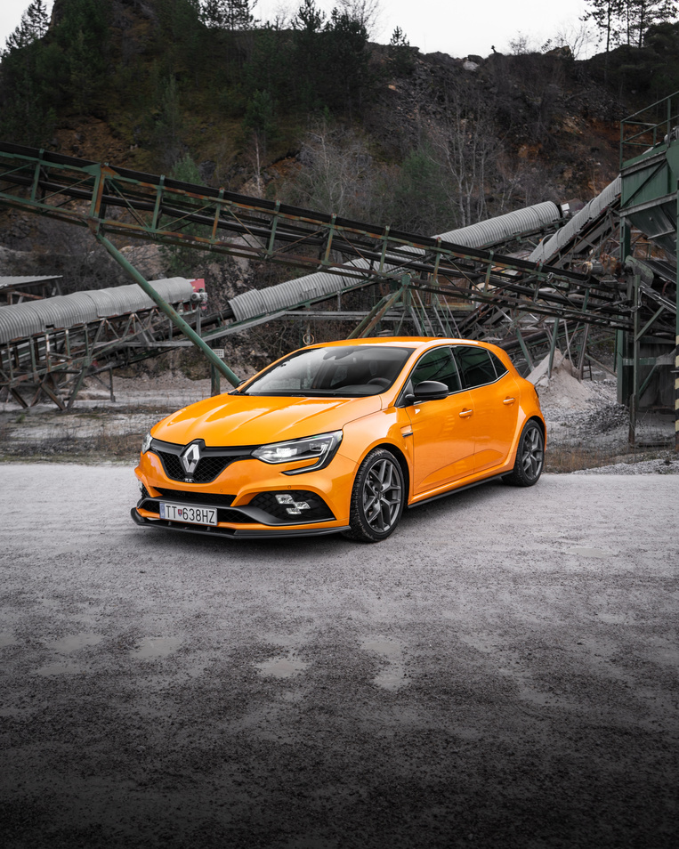
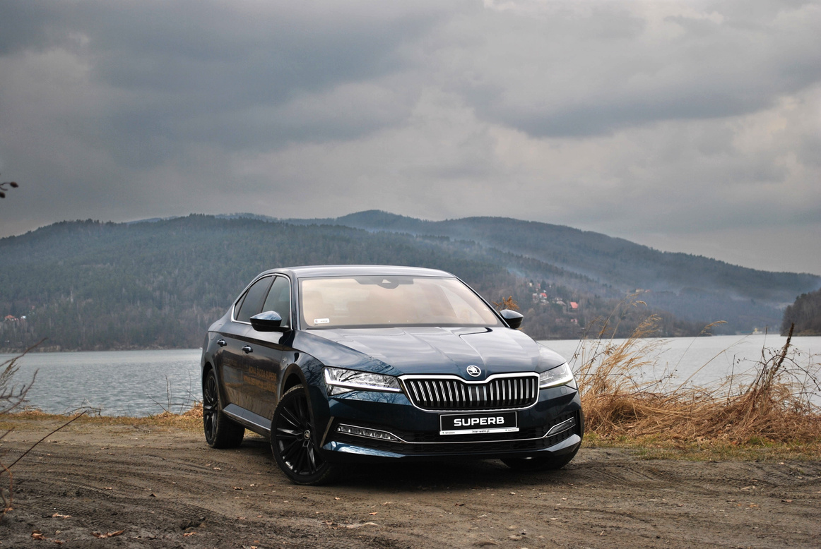
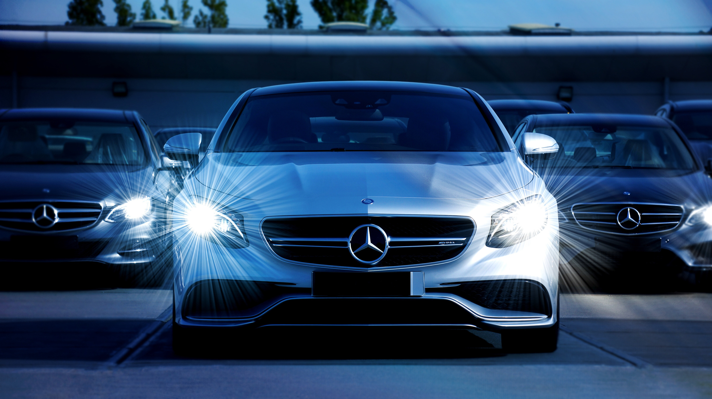
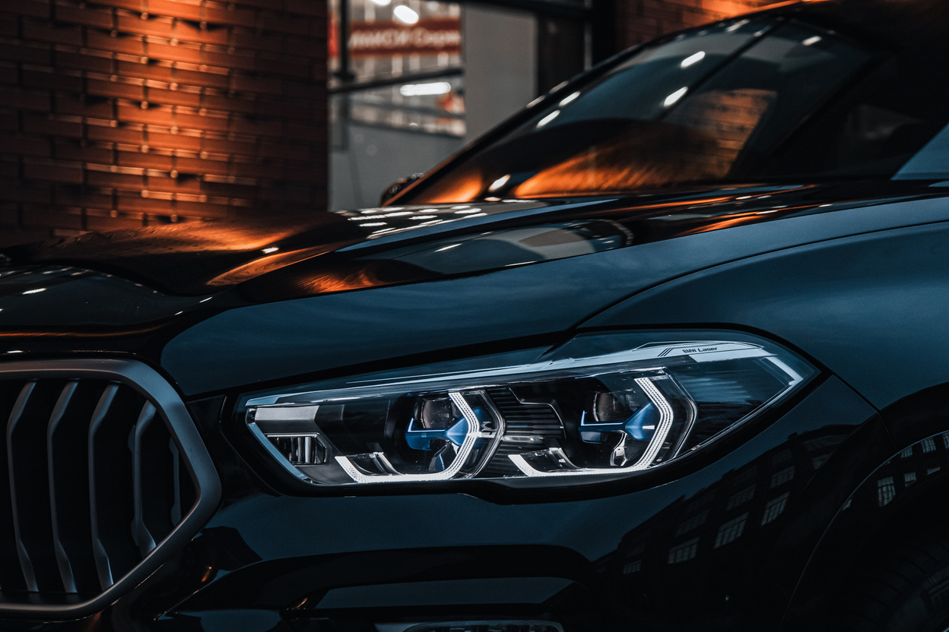
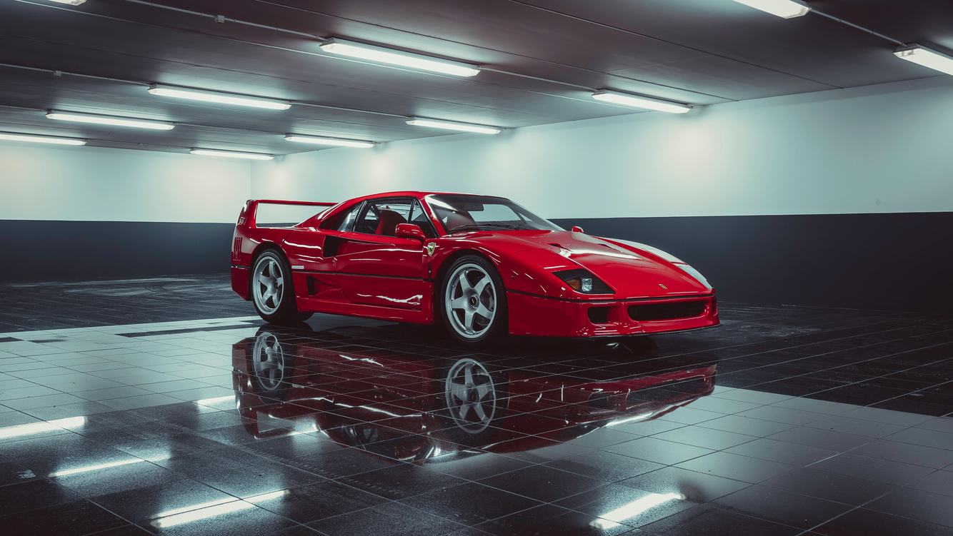
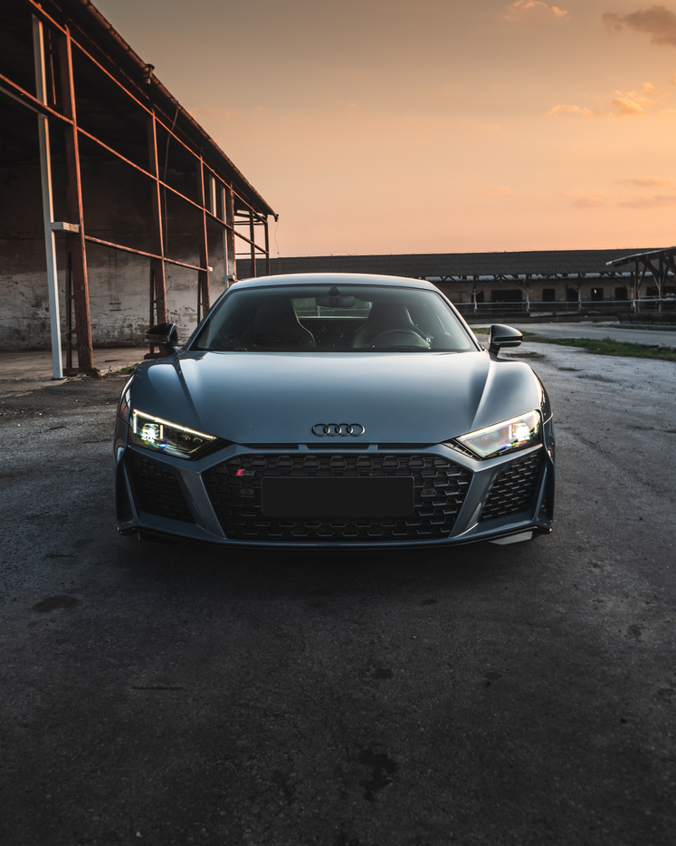
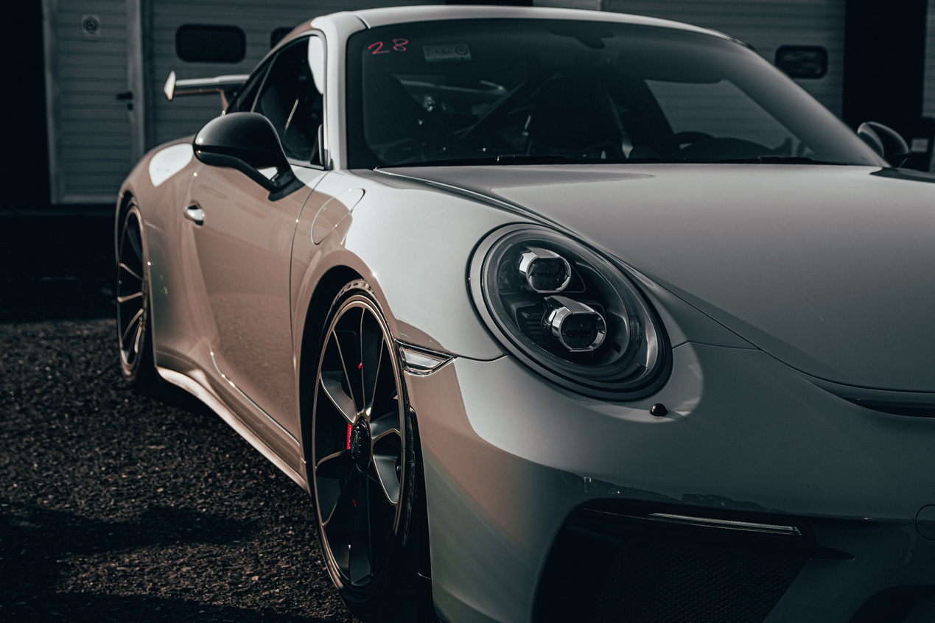
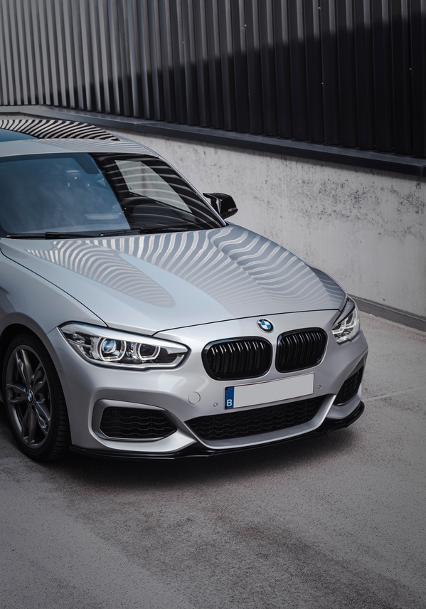
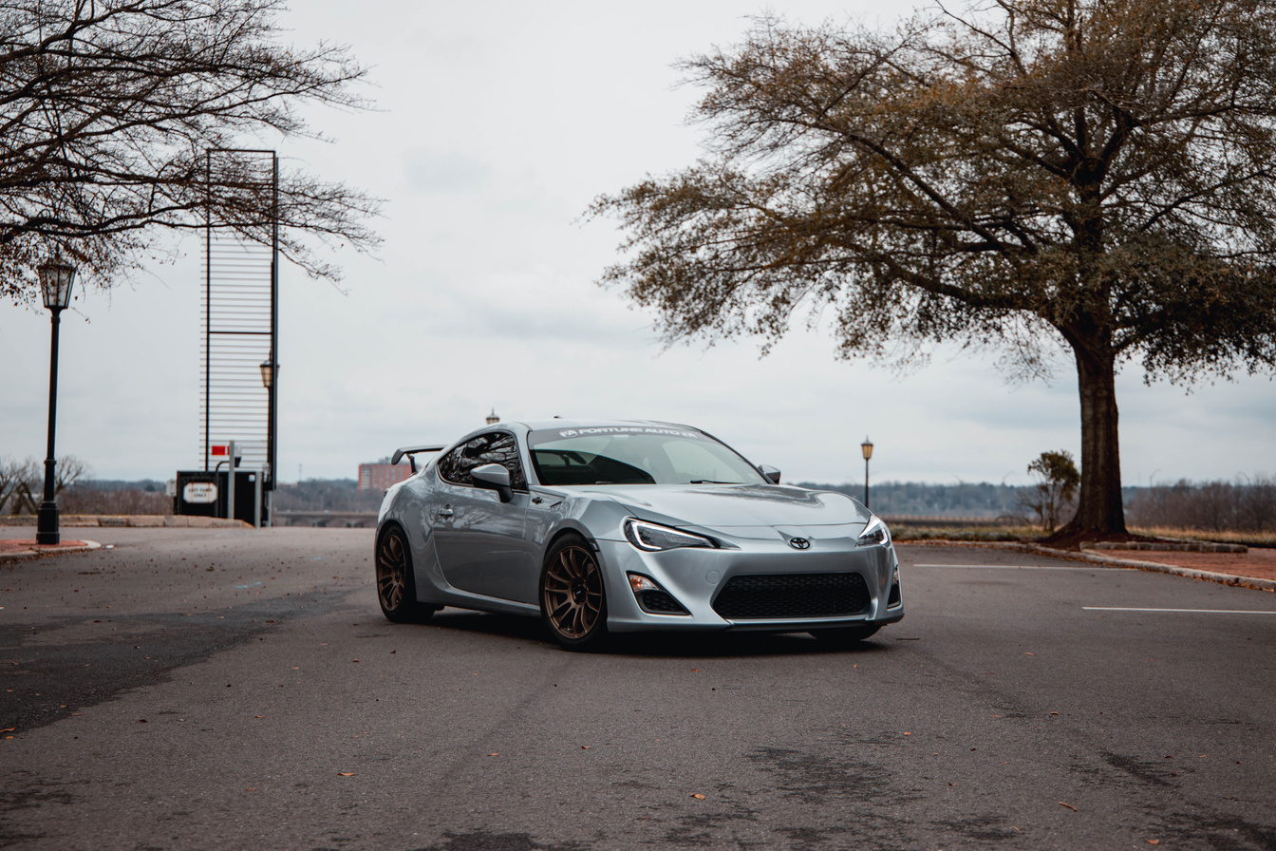
THANK'S FOR
WATCHING

